Slide 1

My Linear Relationships Interactive Notebook
Name
Class
Term 4 Semester 2

Slide 2
Contents
Formula Page
Page
Date
Description
2
3

Slide 3
Tasks
24
7
30
Essential Question
Questions
Notes
Summary
8
9

Slide 4
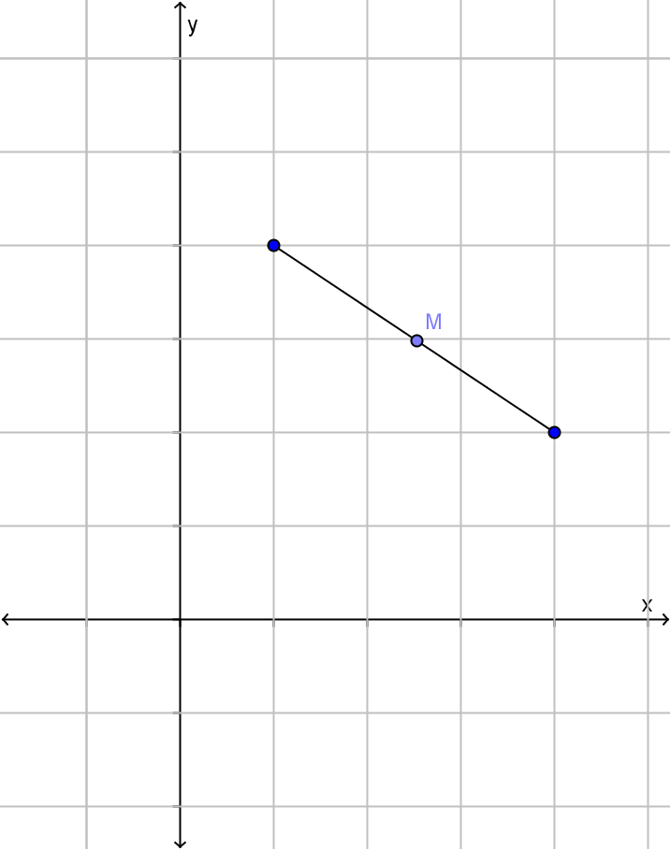
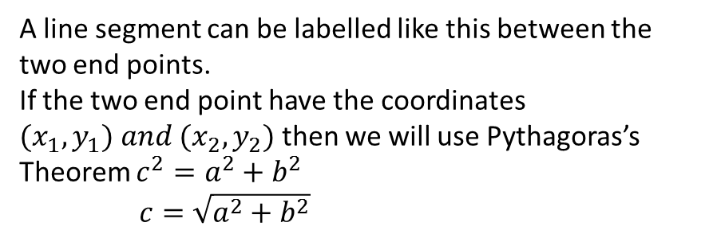


24
7
30
Date
Finding the length of a line
EQ – How is Pythagoras’ theorem used to find the length of a line between two points located on a Cartesian plane?
A line segment can be labelled like this between the two end points.
If the two end point have the coordinates ${(x}_{1},y_{1}) and (x_{2},y_{2})$ then we will use Pythagoras’s Theorem $c^{2}=a^{2}+b^{2}$
$c=\sqrt{a^{2}+b^{2}}$
$${(x}_{1},y_{1})$$
$${(x}_{2},y_{2})$$
9

Slide 5
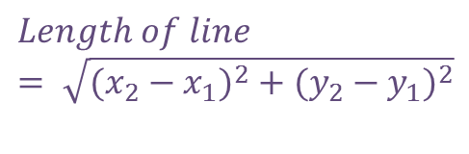

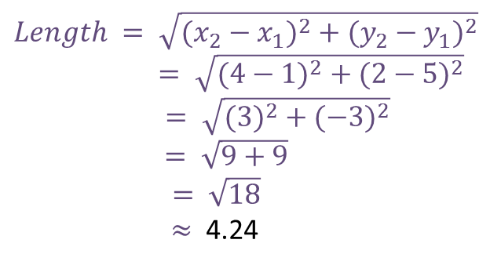

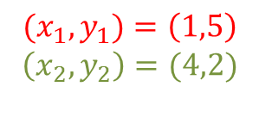



24
7
30
Date
Finding the length of a line
EQ – How is Pythagoras’ theorem used to find the length of a line between two points located on a Cartesian plane?
Using Pythagoras’ theorem – we will go through this later
$$Length of line= \sqrt{({x_{2}−x_{1})}^{2}+{(y_{2}−y_{1})}^{2}}$$
$$(1,5)$$
Example
$${(x}_{1},y_{1})=\left(1,5\right)$$
$$\left(x_{2},y_{2}\right)=(4,2)$$
$$Length of line= \sqrt{({x_{2}−x_{1})}^{2}+{(y_{2}−y_{1})}^{2}}$$
$$Length = \sqrt{({x_{2}−x_{1})}^{2}+{(y_{2}−y_{1})}^{2}}$$
$= \sqrt{({4−1)}^{2}+{(2−5)}^{2}}$
$= \sqrt{({3)}^{2}+{(−3)}^{2}}$
$= \sqrt{9+9}$
$= \sqrt{18}$
$≈$ 4.24
($y_{2}−y_{1})$
(4$,2)$
$${{(x}_{2}−x_{1})}^{}$$
9

Slide 6
Exercise 16 – 1 & 2
All Questions
Pages 214 - 215

Slide 7
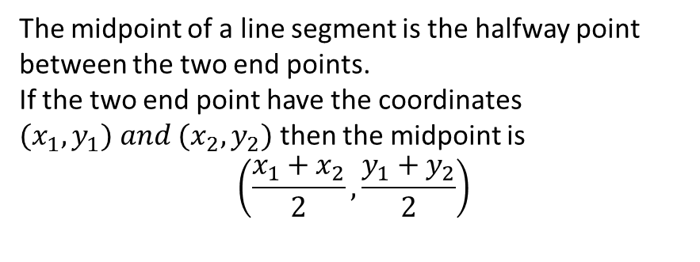
24
7
30
Date
Finding the midpoint of a line
EQ – How can you find the midpoint of a line between two points located on a Cartesian plane?
The midpoint of a line segment is the halfway point between the two end points.
If the two end point have the coordinates ${(x}_{1},y_{1}) and (x_{2},y_{2})$ then the midpoint is
$$\left(\frac{x_{1}+x_{2}}{2},\frac{y_{1}+y_{2}}{2}\right)$$
$${(x}_{1},y_{1})$$
$${(x}_{2},y_{2})$$
9

Slide 8
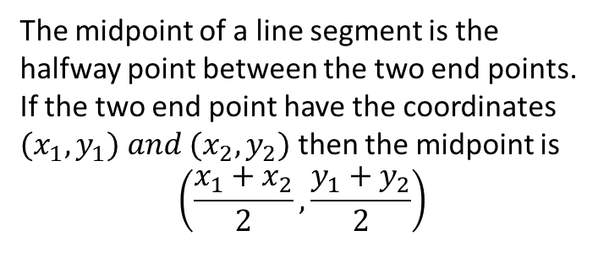
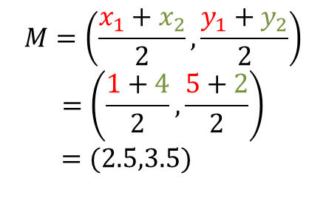



24
7
30
Date
Finding the midpoint of a line
EQ – How can you find the midpoint of a line between two points located on a Cartesian plane?
Reminder - $Length of line= \sqrt{({x_{2}−x_{1})}^{2}+{(y_{2}−y_{1})}^{2}}$
The midpoint of a line segment is the halfway point between the two end points.
If the two end point have the coordinates ${(x}_{1},y_{1}) and (x_{2},y_{2})$ then the midpoint is
$$\left(\frac{x_{1}+x_{2}}{2},\frac{y_{1}+y_{2}}{2}\right)$$
$$(1,5)$$
Example
$${(x}_{1},y_{1})=\left(1,5\right)$$
$$\left(x_{2},y_{2}\right)=(4,2)$$
(4$,2)$
$$M=\left(\frac{x_{1}+x_{2}}{2},\frac{y_{1}+y_{2}}{2}\right)$$
$$=\left(\frac{1+4}{2},\frac{5+2}{2}\right)$$
$=(2.5,3.5)$
9

Slide 9
Exercise 16 – 3, 4 & 5
All Questions
Pages 216 - 217

Slide 10
Notes Review
24, 7 ,30
Date
Title
Essential question
Notes complete
Notes complete with colour and diagrams
Questions completed
Contents page filed in
Formula page filled in

Slide 11
Homework
Review your notes and write a summary answering the essential question.

